Slide 1

Agile SDLC Model
Muhammad Usman Saeed (1045)
BSIT 4th Morning
2015-2019

Slide 2
Contents
What is Agile
Agile Development Life Cycle
Working of Agile
Advantages
Disadvantages
References

Slide 3
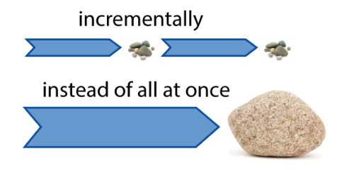
Agile Model
Agile is a Software Development Methodology
It means ‘ability to move quickly and easily’ and responding swiftly to change
It is a multi-iterative lifecycle.
Develop and deliver software incrementally from the start of the project, instead of trying to deliver it all at once near the end.

Slide 4
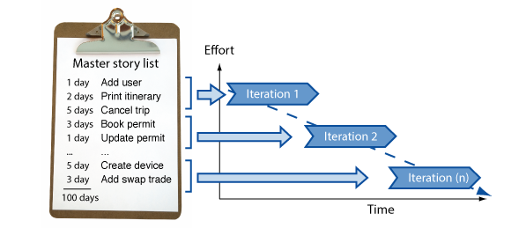
Agile (Cont.)
One Iteration is typically 1 to 4 weeks
The development is aligned with the changing business needs
It works by breaking projects down into little bits of user functionality called user stories, prioritizing them, and then continuously delivering them in short two week cycles called iterations.

Slide 5
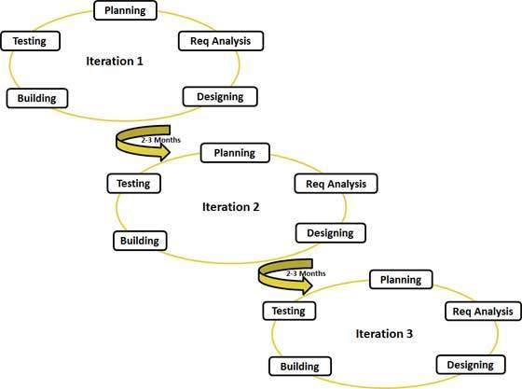
Agile Life Cycle

Slide 6
How does it work?

Slide 7
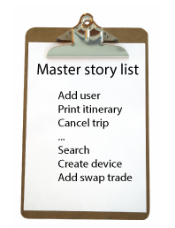
Make a List
Sitting down with the customers
Make a list of features they would like to see in their software.
We call these things user stories
They become the To Do list for project.

Slide 8
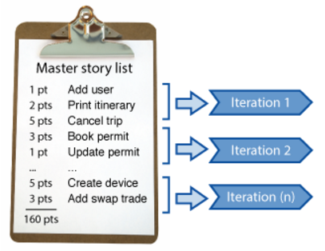
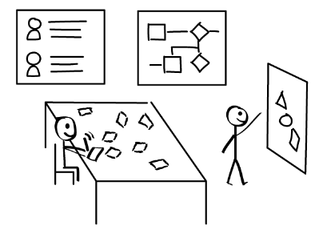
User Stories

Slide 9
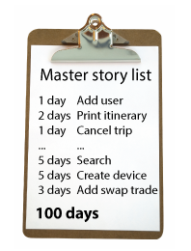
Size Things up
Size user stories using Agile estimation techniques
Coming up with a guess as to how long each user story will take.

Slide 10
Size Things up
Size user stories using Agile estimation techniques
Coming up with a guess as to how long each user story will take.

Slide 11
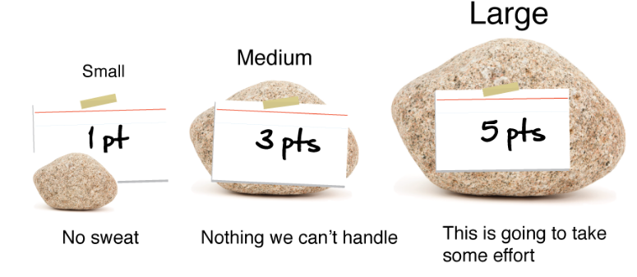
Time Estimation
Relatively sizing means – don’t worry about exactly how big a story is.
Worry more how this story’s size compares to others.

Slide 12
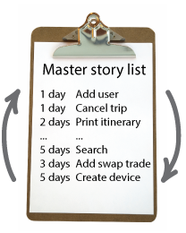
Set Priorities
Like any other lists, there always seems to be more to do than time allows.
Ask the customer to prioritize their list
Get the most important stuff done first, and save the least important for last.

Slide 13
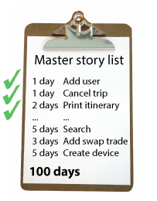
Start Project
Start delivering some value.
Start at the top. Work your way to the bottom.
Building, iterating, and getting feedback from your customer as you go.

Slide 14
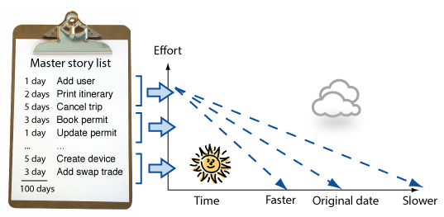
Update Plans
Then, as you and your customer starting delivering, one of two things is going to happen. You'll discover:
  You're going fast enough. All is good.
  Or, You have too much to do and not enough time.
  At this point you have two choices. You can either a) do less and cut scope (recommended). Or you can b) push out the date and ask for more money.

Slide 15
Advantages
Customer satisfaction through early and continuous software delivery.
Requirements can be changed during development process.
Frequently delivering of working software.
Support, trust and motive the customer.
Enable face to face interaction.
Regular interaction with software to make it more effective.

Slide 16
Disadvantages
In case of some software deliverables, especially the large ones, it is difficult to assess the effort required at the beginning of the software development life cycle.
There is lack of emphasis on necessary designing and documentation.
The project can easily get taken off track if the customer representative is not clear what final outcome that they want.
Only senior programmers are capable of taking the kind of decisions required during the development process.

Slide 17
References
https://www.tutorialspoint.com/sdlc/sdlc_agile_model.html
http://istqbexamcertification.com/what-is-agile-model-advantages-disadvantages-and-when-to-use-it/
http://www.agilemodeling.com/essays/introductionToAM.html
https://en.wikipedia.org/wiki/Agile_software_development

Slide 18




